Slide 1
Database
Database is integrated collection of related information along with the details so that it is available to the several user for the different application.
Database Name
Row or Record or Tuple
Entity
Student
Table Name: Computer Science
Column or Field or Attributes
Roll Number | Name | Address | Fees
1 | Rahul | Delhi | 10000
2 | Raj | Mumbai | 5000
3 | Rohit | Kolkata | 15000
DATABASE

Slide 2
Table Name: Users
user_id | password
Sam12 | Xyz
Rony23 | Zxy
John90 | Qwerty
James | iuytr23
Facebook
Table Name: Pages
page_name | likes
Cdac jaipur | 3000
Etc | 100000
Other | 5000000

Slide 3
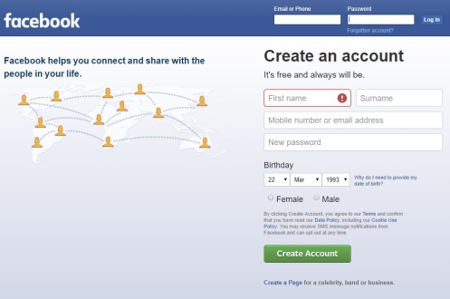
Table Name: Users
user_id | password
Sam12 | Xyz
Rony23 | Zxy
John90 | Qwerty
James | iuytr23
Facebook
Table Name: Pages
page_name | likes
Cdac Jaipur | 3000
Etc | 100000
Other | 5000000

Slide 4
PHP Supports various Databases
MySQL
MS-SQL
SQLite
MongoDB
Oracle OCI8
PostgreSQL

Slide 5
MySQL/MariaDB
MySQL/MariaDB is a database management system.

Slide 6
There are three main API options when considering connecting to a MySQL database server:
PHP's MySQL Extension
PHP's mysqli Extension
PHP Data Objects (PDO)
http://www.php.net/manual/en/mysqli.overview.php

Slide 7
CRUD
Create
Read
Update
Delete

